Slide 1

Chicago Traffic Crashes
Team 12 – Jiayi, Jiechen, Dhaval, Divya

Slide 2

Motivation
Alleviating Human Impact
Improving Public Safety
Mitigating Financial Toll
Proactive Protection
Lifesaving Interventions
Notes:
Human Impact: Excessive accidents have real consequences for people's lives - trauma, losses, and suffering we aim to alleviate.
Public Safety: These models enable agencies to directly protect public wellbeing by informing preventative actions.
Financial Toll: Mitigating crashes provides economic relief by reducing the over $100 million annual price tag of accidents.
Proactive Protection: We can now pivot from reactive to predictive - getting ahead of risks instead of responding after the fact.
Lifesaving Insights: Our models translate to interventions that save lives by flagging conditions requiring heightened vigilance.

Slide 3
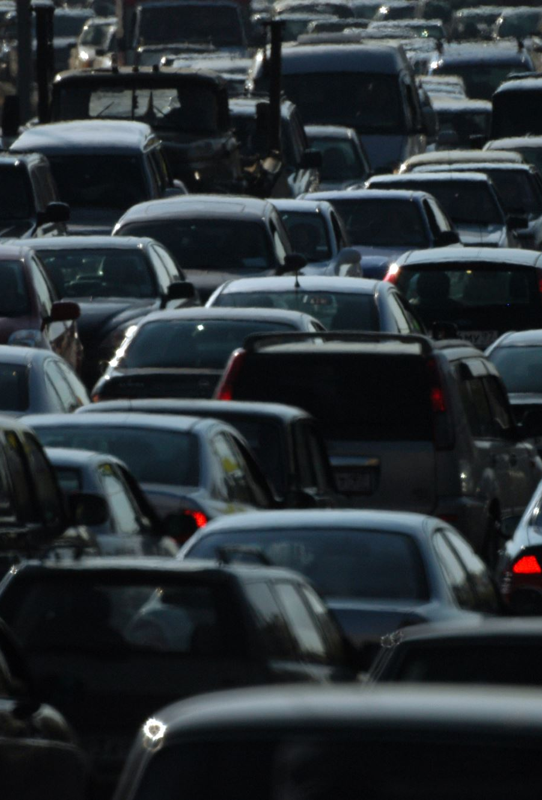
Gathering Data
Sources:
Traffic Crashes data from the City of Chicago Data Portal
Weather Data from Visual Crossing
Contents: Detailed incident-level records on all reported motor vehicle crashes in the City of Chicago from 2015 to present
Volume: Over 700,000 crash observations, spanning 49 attributes
Key Strengths:
Large in-scope duration - 7 years of data
Granular details and insights per incident
Tailored to city infrastructure and traffic conditions

Slide 4







Data Overview
Location: Latitude and Longitude, Distance to Downtown
Date and Time: Hour of day/ day of week/day of month
Injuries: Number and type of injuries that occurred
Damages: Estimated damage cost of crash
Crash Type: Type of crash – no right of way, intersection related etc.
Weather Conditions: Weather, Lighting, traffic, traffic control devices, roads etc.

Slide 5



Research Questions
How long does it take for the police to be notified upon accident?
Can we identify high-impact accidents based on crash characteristics?
Notes:
Given that there is a crash, based on the location, time, crash type, and surrounding road and traffic conditions, how much damage is to be expected (<=1.5K$ or >1.5K$
How long it takes in minutes for police to be notified upon accident, given the nature of the accident?

Slide 6
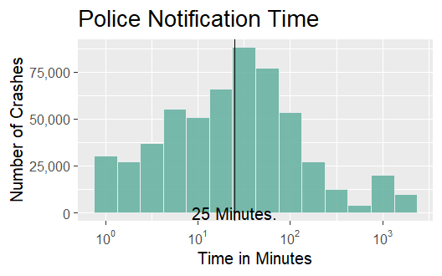
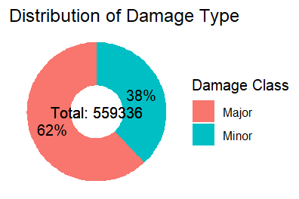
Exploratory Data analysis

Slide 7
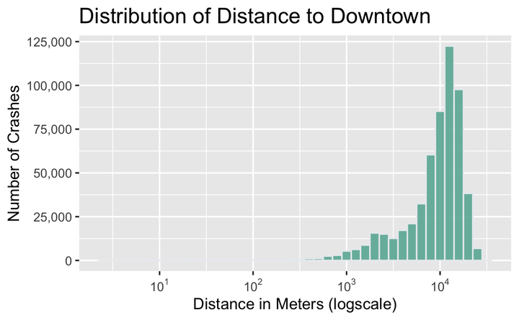
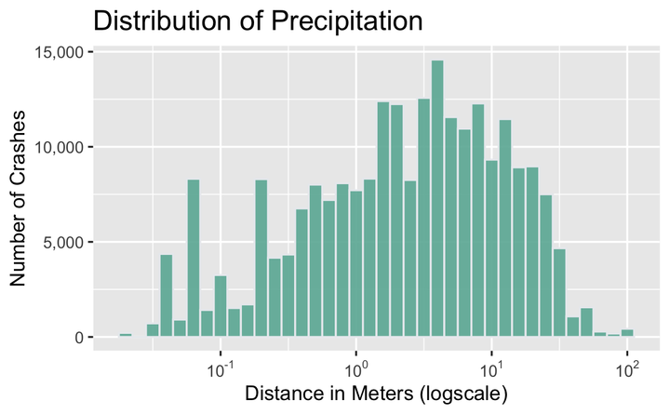
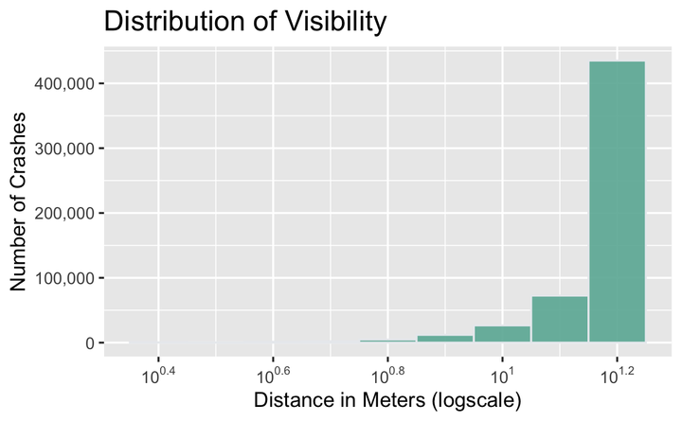
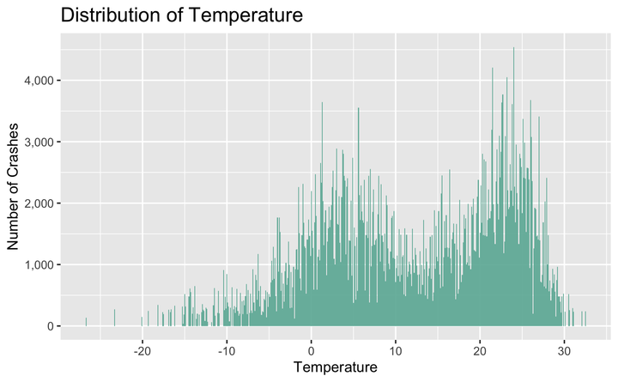
Exploratory Data analysis

Slide 8






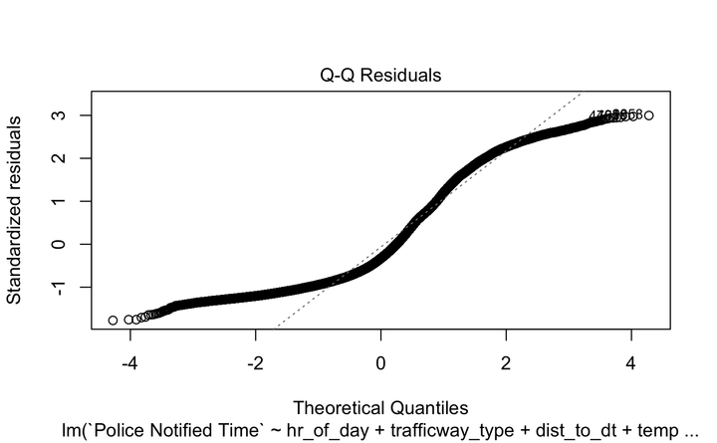
Model 1: Time to Notify Police
Question: How long, in minutes, does it take for the police to be notified upon accident?
Method: Estimate Time to Notify Police
Time Taken: Continuous (Minutes)
Method: Linear Regression
Results
The Q-Q plot on the left shows significant tail-behavior and indicates possible non-linearity in the data
Additional weather/location variables didn't improve model fit, with a 4.5% R2 score

Slide 9


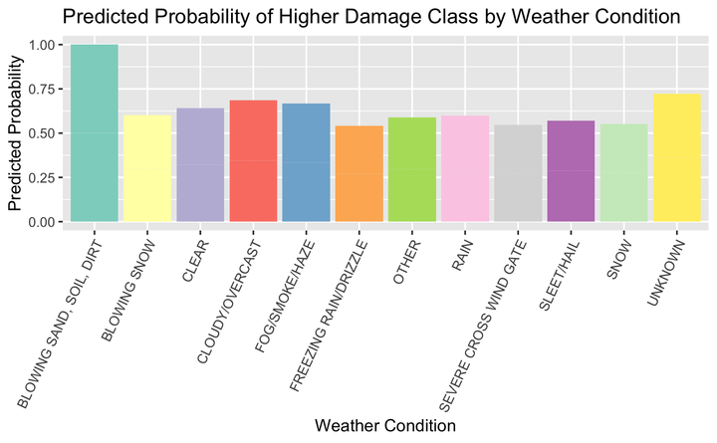
Model 2: Cost Impact Classification
Question: Can we identify high-impact accidents based on crash characteristics?
Method: Cost Impact Classification
Damage Size: < $1.5K or > $1.5K
Method: Logistic Regression
Results
Even Distribution in Prediction Probability
Stability Post-Outlier Exclusion
Mixed Levels of Multicollinearity
Moderate Accuracy in Severe Accident Prediction (True Positives)

Slide 10

Limitations and future work
Limitations
Challenge: Removed missing values because no information on missing
Risk: Added external data that may misrepresent the dataset
Potential Improvement
Address Missing Values: Identify reasons for missing data and perform imputation
Enhance Dataset: Include additional variables for a comprehensive view
Driver-related Variables: Age, gender, years of driving, drinking alcohol
Behavioral Variables: Speeding, distracted driving (phone use, etc.), seatbelt usage
Introduce new models: Decision Trees, Random Forest

Slide 11



Thank You

